Slide 1

The Battle of Neighborhoods
Opening a New Thai Restaurant in New York City
Toh Khai Chun

Slide 2
Business Problem
THE CHOICE OF LOCATION IS A CRITICAL CONSIDERATION IN THE PLAN
AIM:
EXPLORE AND SELECT THE BEST LOCATION FOR OPENING A NEW THAI RESTAURANT

Slide 3
DATA
DATA REQUIRED:
Population And Density Of The New York City’s Five Boroughs
Geographical Coordinates Of Neighborhoods
Venue Data Related To Thai Restaurants
SOURCES OF DATA
Borough Table Of Wikipedia Page: https://en.wikipedia.org/wiki/New_York_City#Boroughs
Geographical Coordinates Of NYC: https://geo.nyu.edu/catalog/nyu_2451_34572
Foursquare API For Venue Data

Slide 4
Methodology
Web Scraping Wikipedia Page For Population And Density Table
Load Geographic Coordinate Data From NYU Spatial Data Respository
Use Foursquare API To Get Venue Data
Group Data By Neighborhoods And Boroughs With Filtering Venue Category Of Thai Restaurants To Find Out Thai Restaurant Number Of Each Neighborhood And Each Borough
Group Data By Neighborhoods And Taking The Mean Of Occurrence Frequency Of Each Venue Category, Particularly Thai Restaurants
Perform K-mean Clustering And Visualize Cluster In Map Using Folium

Slide 5
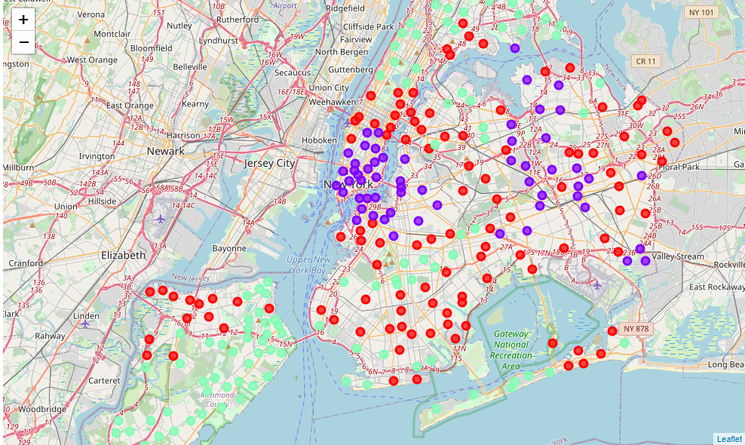
Result
Categorized The Neighborhoods Into 3 Clusters
Cluster 0: Neighborhoods With Moderate Number Of Thai Restaurants
Cluster 1: Neighborhoods With High Density Of Thai Restaurants
Cluster 2: Neighborhoods With The Rarest Thai Restaurants

Slide 6
Discussion
Most Of The Thai Restaurants Are Concentrated In The Central Area And East Area Of New York City
Highest Number In Cluster 1 And Moderate Number In Cluster 0
Cluster 2 Has Very Low Number To Almost None Of Thai Restaurants

Slide 7
Recommendation
Recommend To Open New Thai Restaurant In The Bronx:
Is One Of The Boroughs In Cluster 2
Is The Borough That Has Least Number Of Thai Restaurants
Is The Third Most Densely Populated County In The New York City (NYC).

Slide 8
Conclusion
Identify Neighborhoods Of New York City With A Low Presence Of Thai Restaurants
Analyzed The Population Amount Of Boroughs In The NYC
Find Out The Thai Restaurant Number For Each Neighborhood And Each Borough
Identify Thai Restaurant Presence In Each Neighborhood From Foursquare Data We Have Clustered
The Best Location For Opening A New Thai Restaurant Will Be Decided By Investors Or Caterers

